Slide 1
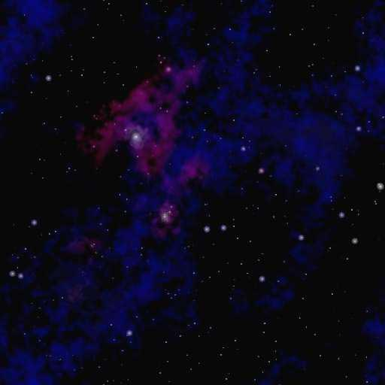
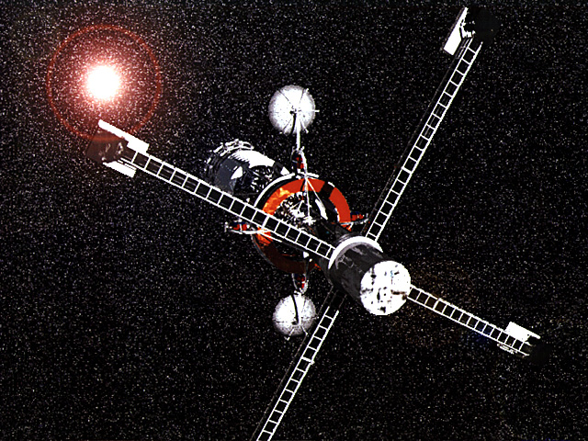
INTERSTELLAR TRAVEL
The Good News… The Bad News..

Slide 2
Begin with the obvious:
Distances between the stars is overwhelming
Life bearing planets are NOT simply the nearest neighboring stars
Interstellar travel as portrayed by Hollywood GROSSLY OVERSIMPLIFIES the basic physical limitations and requirements
Funding interstellar missions would be difficult if not impossible
Tremendous costs involved
No immediate return from investment

Slide 3
Fallacy:
Interstellar travel can be achieved simply by future advances in technology.
Examples:
The limits of sailing ships were exceeded with steam ships
The speed limits of propeller aircraft were exceeded by jet aircraft
The altitude of aircraft were exceeded by rockets

Slide 4
Issues to deal with:
Overwhelming distances
Energy limitations
Propulsion
Supplies
Emergencies
Who goes?

Slide 5
Historical Achievements in Speed
Reaching Alpha Centauri (4.3 ly)
Automobiles (55 mph)
53 million years
Apollo Lunar Missions (25,000 mph)
118,000 years
Interplanetary Missions (37,000 mph)
80,000 years
(0.004% light speed) !
Notes:
The closest Pioneer 10 will pass near any star over the next million years is 3.3 ly. It will be in the general neighborhood of Aldebaran in 2 million years.

Slide 6
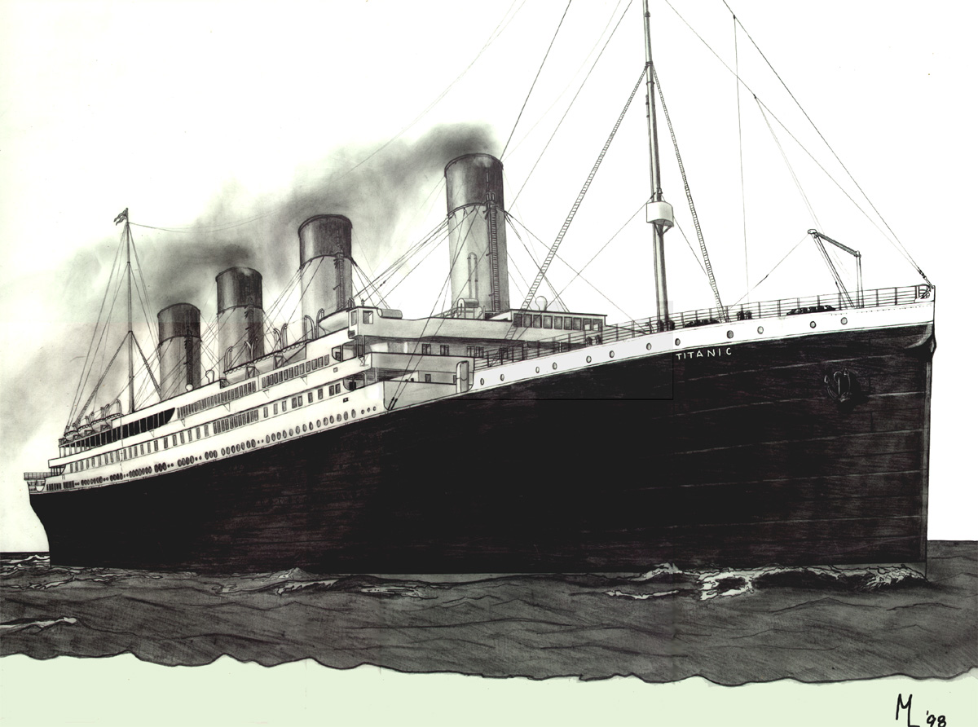
The Energy Issue:
A conservative estimate: Titanic
18,000 kg per passenger
100 million kg ship
Traveling at 10% light speed
40 years to nearest stars
4.5x10²² joules of energy needed
100 times the world annual energy use.
10¢ per kilowatt hour = $3x10¹⁸

Slide 7
IST: Different levels of possibilities
IST over short timescales (days, weeks or months)
Faster than light travel
IST over human lifetimes (years or decades)
Near light speed travel
IST over multiple generations (centuries or hundreds of centuries)
Sub-light speed travel

Slide 8
The Propulsion Issue:
General problem:
High thrust = Inefficient propulsion

Slide 9
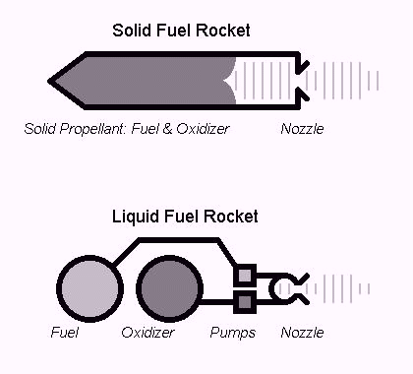
Chemical Bipropellant
Chemical reaction creates expanding gasses that are expelled out a very narrow nozzle propelling the spacecraft forward

Slide 10
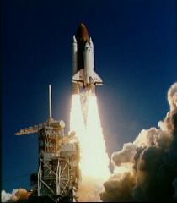
Chemical Bipropellant (cont’d)
Thrust: 0.1 - 10⁷ Newtons
Specific Impulse (measure of efficiency of engine): 100 – 400
Pro: powerful, relatively cheap, abundant chemicals
Con: largely inefficient
Currently the propellant of choice in modern rocketry

Slide 11
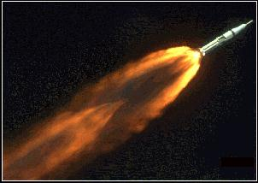
Example: Saturn V Rocket
Oxygen + kerosene fuel mixture
Multistage rocket more efficient
Outweighed the payload 60:1

Slide 12
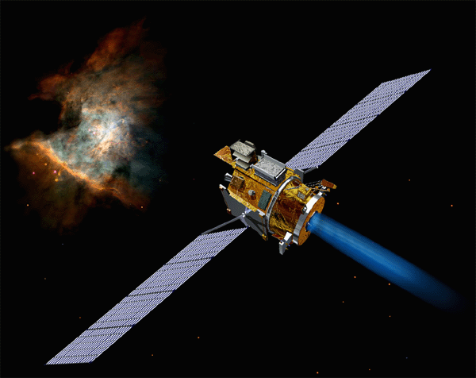
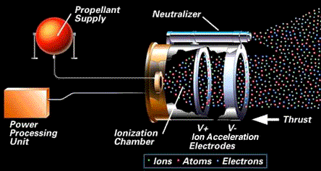
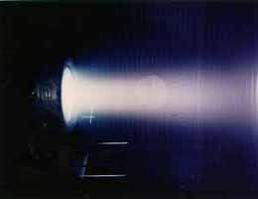
Electromagnetic Propulsion
Ionized gasses are electrically accelerated and expelled propelling a spacecraft forward
Ionized Xenon gas
Accelerated ionized gasses provide thrust
Ejected ions travel at 67,000 mph

Slide 13
Electromagnetic Propulsion (cont’d)
Thrust: 30 Newtons
Specific Impulse (measure of efficiency of engine): 1200 – 5000
Pro: relatively simple design…can efficiently achieve high velocities (10 times total speed of chemical rockets)
Con: thrust is minimal… very low acceleration… not intended for massive payloads

Slide 14

Nuclear Propulsion
Binding energy released from nuclear reactions used as energy source for propulsion
High rate of thrust
Very efficient
Pro: Relatively high yield of energy from reaction… high speeds achievable
Con: Dangerous to crew

Slide 15
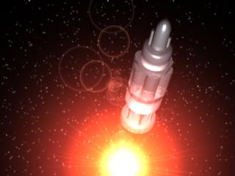
Project Orion (1950’s, 60’s)
Nuclear detonations propel a rocket forward
1 – 5 detonations per second increasing in yield
Thrust: 10⁹ – 10¹² Newtons
Specific Impulse: 2000 – 100,000
Scrapped due to Nuclear Test Ban Treaty

Slide 16
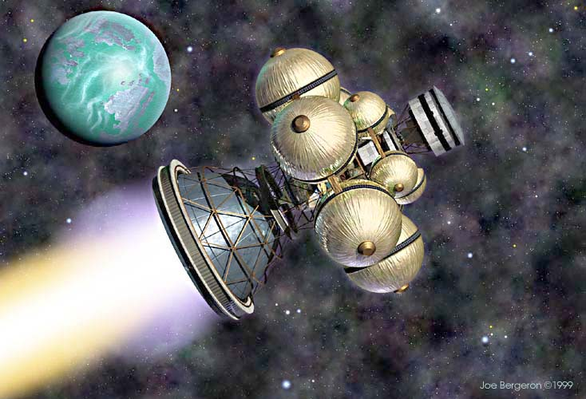
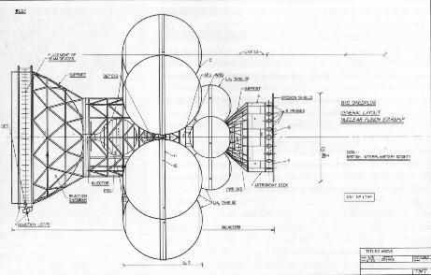
Project Daedalus: British Interplanetary Society (1970’s)
Scaled down version of Orion
Micro fusion reactions
Speeds of 15% light speed
30 – 40 year journey to Barnard’s star (6 ly)

Slide 17
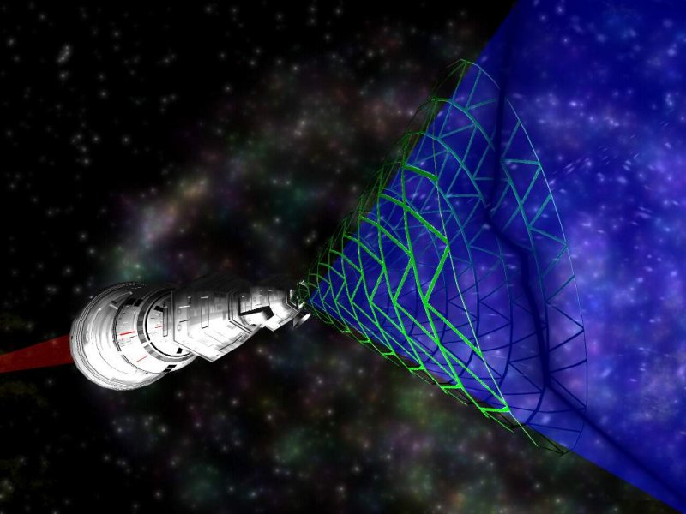
Bussard Interstellar Ramjet
Large “scoop” collects interstellar hydrogen
Hydrogen used in fusion propulsion
Problems with the drag created by the “scoop”

Slide 18
Matter/Antimatter Annihilation
Combination of matter and antimatter yields energy via E=mc²
100% of matter is converted to energy
100 times more energy released compared to hydrogen fusion
Problems with manufacturing of antimatter and containment of antimatter

Slide 19
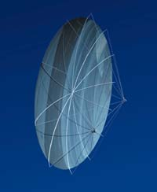
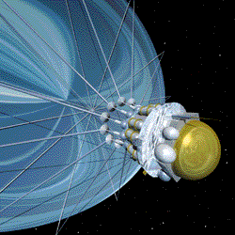
Laser Sail
High energy laser beam is concentrated onto a lightweight sail
Sail is propelled forward carrying a small payload
Problems: ENORMOUS laser energies needed to propel even the smallest payload.
Acceleration to 50% light speed would require 1000 times the power of all human power consumption!

Slide 20
Conclusion:
Every imaginable propulsion system has a monumental fuel problem
Antimatter annihilation is most efficient
If 99% light speed is desired
~200 x (mass of final payload) is necessary as fuel
Roundtrip requires 40,000 x (mass of final payload) is necessary as fuel
Skylab would have required 12 million tons of fuel for such a journey!

Slide 21
Revolutions in propulsion systems might make IST more efficient…
BUT:
Does not address limitations imposed by laws of physics
Does not address limitations imposed by the hazards of IST
Does not address limitations imposed by the human requirements of IST

Slide 22
Does this mean the we give up?
NASA’s Breakthrough Propulsion Physics Project (BPP)
Goals:
Discover new propulsion methods that eliminate or dramatically reduce the need for propellant
Discover how to attain the ultimate achievable transit speeds to dramatically reduce deep space travel times
Discover fundamentally new on-board energy production methods to power propulsion devices
VERRRY small budget… ~$100,000’s

Slide 23
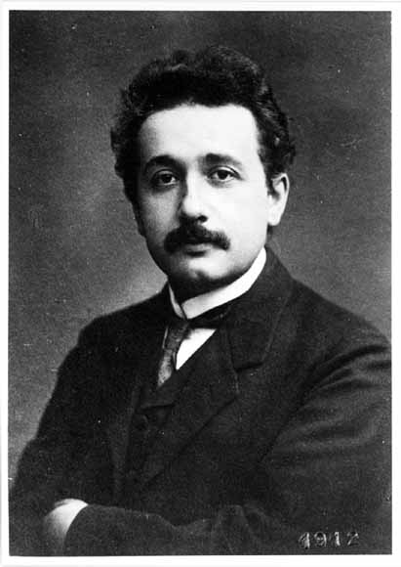
Interstellar Travel at NEAR Light Speed
Why not travel AT light speed?
Violation of laws of physics
Relativity governs physics as we approach light speed:

Slide 24
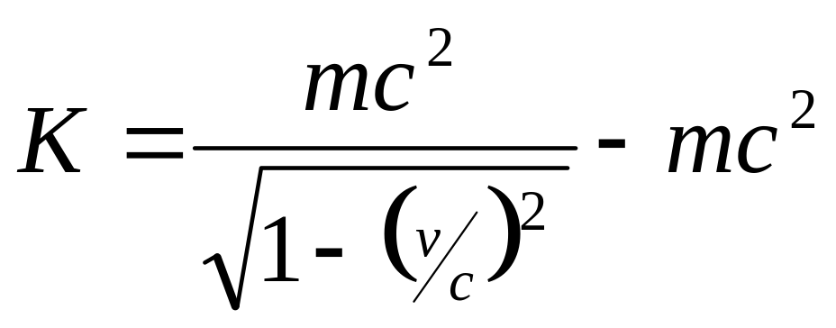
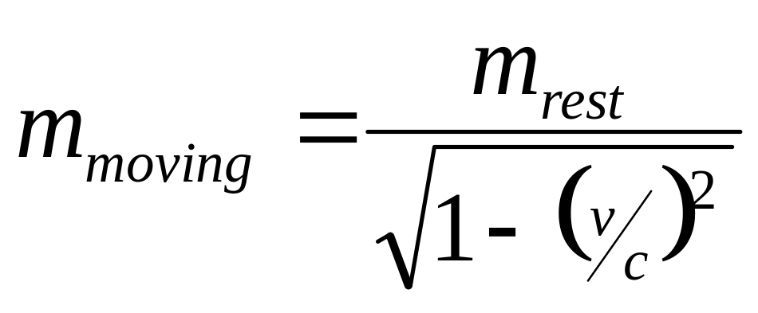
As velocity increases so does kinetic energy. If v=c then K goes to infinity.
As velocity increases so does m_{moving}. If v=c then m_{moving} goes to infinity.

Slide 25
RESULTS:
Nothing with mass can travel AT the speed of light
However NEAR light speed is possible

Slide 26
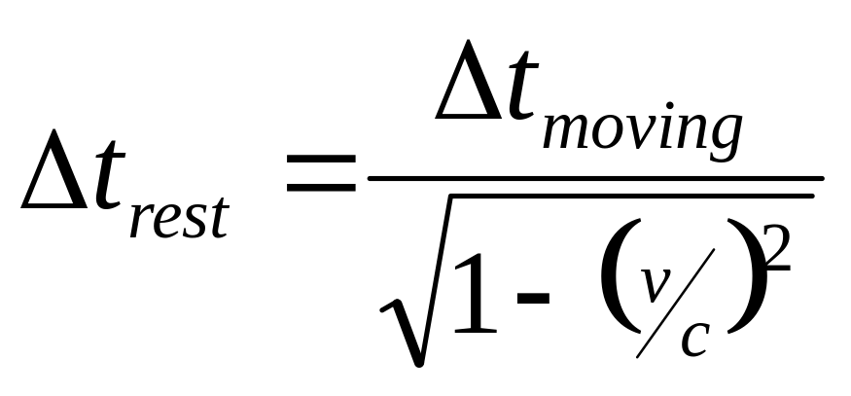
Advantages of NEAR light speed travel: Relativistic Time Dilation
The measurement of the passage of time is relative to the frame of reference
The passage of time for someone moving at high speeds appears slower as seen by an observer at rest

Slide 27
50% light speed
At 50% c
1.15 seconds on earth pass for every 1 second measured by a traveler
A 10 lightyear journey would take 20 earth years
Travelers would experience a 17 .4 year journey

Slide 28
75% light speed
1.5 seconds on earth pass for every 1 second measured by a traveler
A 10 lightyear journey would take 13 earth years
Travelers would experience a 8.7 year journey

Slide 29
99% light speed
At 99% c
7 seconds on earth pass for every 1 second measured by a traveler
A 10 lightyear journey would take 10.1 earth years
Travelers would experience a 1 year 5 month journey

Slide 30
99.99% light speed
At 99.99% c
71 seconds on earth pass for every 1 second measured by a traveler
A 10 lightyear journey would take 10 earth years
Travelers would experience a 1 month 2 week journey

Slide 31
The Hazards of Interstellar Travel
The Interstellar Medium is not empty!
Onboard supplies are limited
What to do in an emergency?

Slide 32
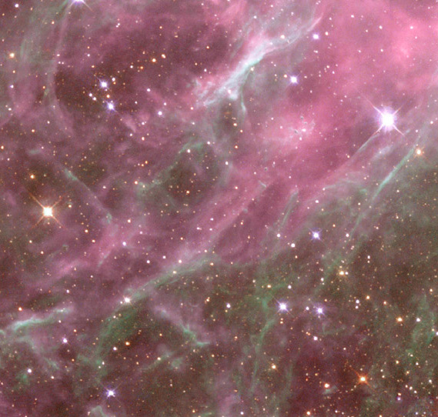
Hazards of the ISM
Travel through the ISM requires more than simply avoiding stars
The ISM contains atoms of gas and dust particles
Travel at high velocities makes impacts devastating!

Slide 33
Limited Onboard Supplies
Bringing necessary supplies adds mass to the payload
Added mass requires more fuel for propulsion
How are supplies kept fresh?
Possible solution could be to “grow as you go”
What about items that are cannot be replenished?

Slide 34

Hibernation as a possible solution?
Still problems with food
Not proven to be a physical reality

Slide 35
What about emergencies?
Mechanical problems
Medical emergencies
Help is NOT on the way…

Slide 36
Faster Than Light Travel?
The General Theory of Relativity suggests dimensions beyond time and 3 dimensional space.
1. Warp Travel
2. Worm Holes

Slide 37
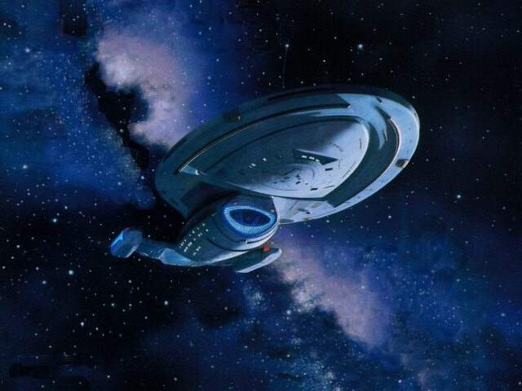
Warp Travel
Compress space in front of your spacecraft… expand space behind your spacecraft
Relativity suggest it might be possible…
Outside observers would see the spacecraft move “faster than light”
Inside observers would not feel an acceleration
Nullifies relativistic time dilation effects

Slide 38
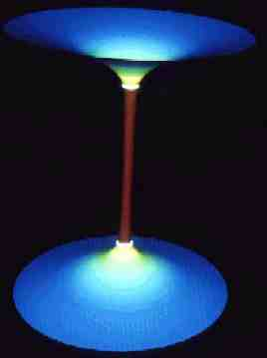
Worm Holes
Rotating black holes create a distortion in spacetime
Complete Schwartzchild geometry allows for a black hole, a white hole and a worm hole in-between
Severe distortions of spacetime allow multidimensional travel
“Predicted” by Einstein’s General Relativity… however seems unlikely to exist
If they exist, Relativity suggests they would be highly unstable and unpredictable

Slide 39
Food For Thought:
If a journey of hundreds of thousands of years or even thousands of years at best is undertaken…
What is unknown and important to us today may not be important to the people of 10,000 or 100,000 years from now

Slide 40
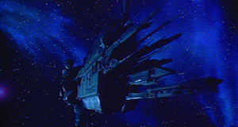
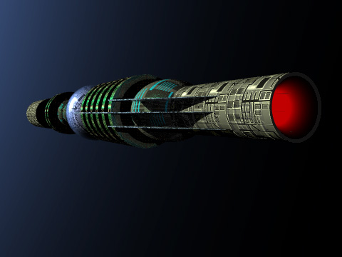
Food For Thought:
A later ship with the ability to travel faster than the original ship would intercept the original ship before it even reaches its destination

Slide 41
Food For Thought:
The very same physics that allows us to travel a near light speeds, also makes near light speeds extraordinarily hazardous!
If multigenerational journeys are undertaken:
The visitors that arrive at an alien world will not be the ones who received the message…
The ones being visited will not be the ones who sent the message…

Slide 42
Chapter 19: 465 – 481
Questions: 1, 3, 4, 5

